Slide 1

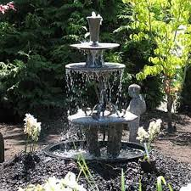
Naan mudhalvan
SMART WATER FOUNTAINS
By using IOT

Slide 2
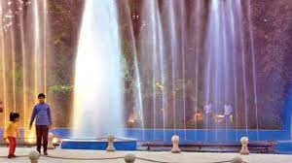
SMART WATER FOUNTAINS
A "smart water fountain in a platform using IoT" refers to a water fountain system that incorporates Internet of Things (IoT) technology to enhance its functionality and efficiency. Here's a breakdown of the key components and features typically associated with such a system:

Slide 3
Details about fountain
Water Fountain: This is the core component, a device that dispenses water for various purposes, such as drinking or decorative purposes.
IoT Integration: IoT technology is integrated into the water fountain to enable connectivity to the internet and other devices. This connectivity allows for remote monitoring, control, and data collection.
Platform: The platform refers to the software and infrastructure that manage the IoT-enabled water fountain. It could be a cloud-based platform or a local server that processes and stores data.

Slide 4
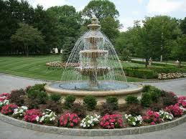
Sensors: Sensors are placed within or around the water fountain to collect data. Common sensors used in a smart water fountain may include water quality sensors (to monitor water cleanliness), flow sensors (to measure water consumption), temperature sensors, and presence sensors (to detect user interactions).
Connectivity: The smart water fountain is connected to the internet via Wi-Fi, cellular networks, or other communication protocols. This enables real-time data transmission and remote control.
Remote Monitoring: Users can monitor the status and performance of the water fountain remotely through a web interface or a dedicated mobile application. They can check water quality, temperature, usage statistics, and receive alerts if there are issues.

